Slide 1
S-98 update VTC
21st November 2025

Slide 2
Agenda
Introductions
S-98
    Progress since October [20m / JP]
    Comment Sheets [60m / All]
    Submitted Paper [20m / UKHO
    Other inputs [20m / JP++]
Forward plan
Other Contributions / AOB?
Next meeting

Slide 3
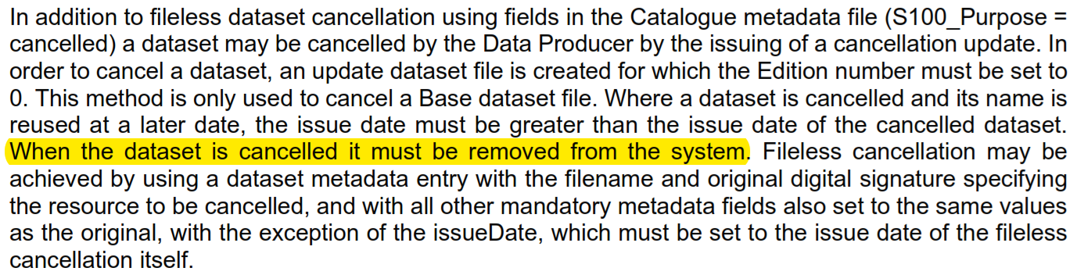
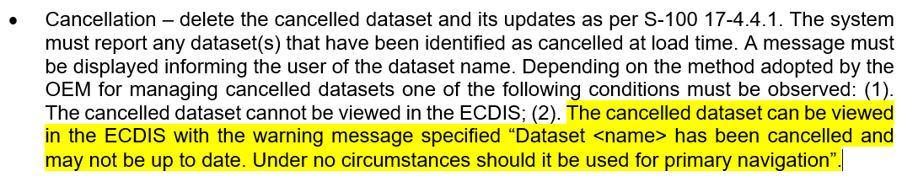
S-124 Progress
Second iteration of S-124 comment adjudication
Exception to the cancellation rule
Needs clarification
Automatic classification
Rationalisation of the requirements
New proposed words.
However, in S-98 20.5, last bullet, there is a statement contradicting this logic:
Perhaps S-98 needs some amendment here to not contradict S-100

Slide 4
interoperabilityIdentifier (and common FOIDs)

Slide 5
S-101
ENC₁
S-101
ENC₂
association
c
Viewport
b
Bridge
pick
a
d
association

Slide 6
Interoperability Identifier is ECDIS functionality. It is a “join field” – it says which features you want to be grouped together when one of them is picked by the pick report. How does it work when you want the NW information to be returned when the user picks a component of the bridge?
S-101
ENC₁
S-101
ENC₂
S-124
e
association
c
Viewport
b
Bridge
pick
a
d
association
What happens when you do a pick report?
Which features do you get information for [a-e]?

Slide 7
S-101
ENC₁
S-101
ENC₂
Viewport
Spatial₁
pick
Spatial₂
foid=1810:238975:35
foid=1810:238975:35
What happens when you do a pick report?
Is the whole feature highlighted? Are the attributes merged (although they should be the same?)

Slide 8
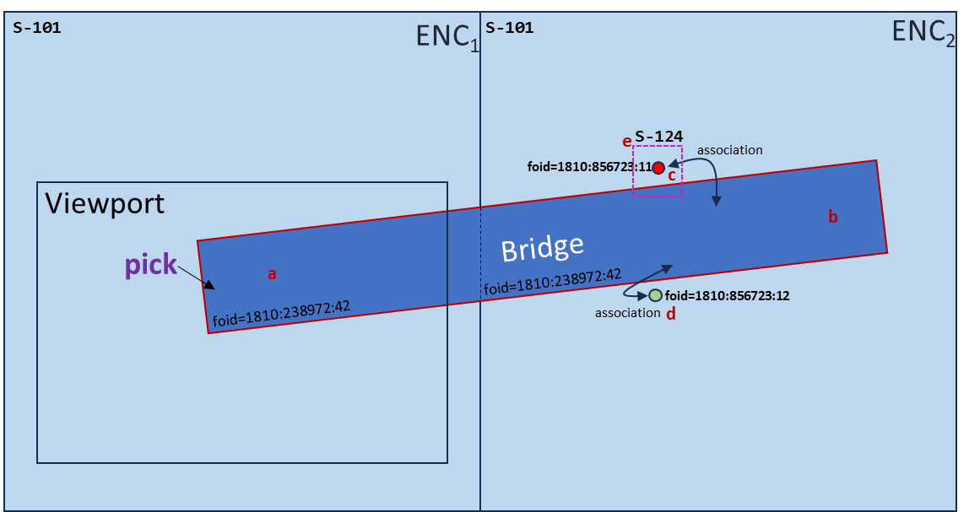
We are trying to do 2 different things:
  Identify features (interoperabilityIdentifer does this)
  Associate between features in different PS, as well as in different datasets (the same PS)
So, interoperablityIdentifier identifies “features”
featureReference.interoperabilityIdentifier contains a reference to “other” identifiers in some product specifications (not all)
The ECDIS must return (in the pick report)
  All features with identical interoperabilityIdentifiers
  Any feature which has a feature reference containing the interoperabilityIdentifier of the picked feature.
There can be multiple feature references in S-124
How can you associate between different datasets (same PS) Using common foid?

Slide 9
So: Features with common foids in the viewport should be merged together for the pick report?
S-101
ENC₁
S-101
ENC₂
association
c
Viewport
b
Bridge
pick
a
foid=1810:238972:42
foid=1810:238972:42
d
association
What happens when you do a pick report (a)?
Feature picked
Common foid
Associated with (b)
Associated with (b)

Slide 10
S-124 NavwarnPart (e):
{
featureReference.interoperabilityIdentifier =urn:mrn:iho:DK00:00365:856723:11
featureReference.interoperabilityIdentifier =urn:mrn:iho:DK00:00365:238973:42
}
S-101 AllRoundLight (c):
{
II=urn:mrn:iho:DK00:00365:238973:42
}
S-101
ENC₁
S-101
ENC₂
Pick Report must return attributes from:
Bridge at picked position
Because foid_{a} = foid_{b}
Because (b) is associated with (c)
Because (b) is associated with (d)
Because II (Bridge) = referenced II (S-124 Navwarn Part)
S-124
e
association
foid=1810:856723:11
c
Viewport
b
Bridge
pick
a
foid=1810:238972:42
foid=1810:856723:12
foid=1810:238972:42
d
association
S-101 Bridge (a) and (b):
{
II=urn:mrn:iho:DK00:00365:856723:11
}

Slide 12
S-98 Inputs
Comment Sheets
  OSI
    Also, 12.5.3 – is it necessary
  Sperry Marine
  ESRI [marked up v2.4.0]

Slide 13
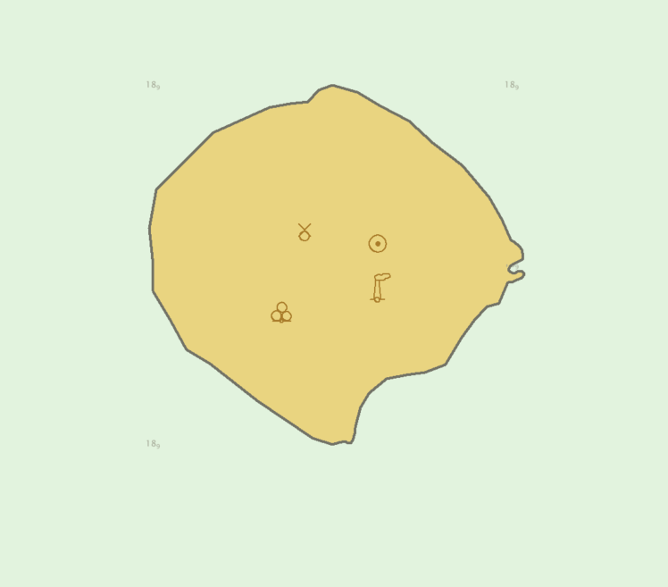
Testing multiple product specifications
Multi dataset test (1st version)
4 datasets
4 feature catalogues, 2.5 2.6 2.7 and 2.8
Landmarks are defined in FC versions

Slide 14
Other Inputs
BS E-Nav Inputs
UKHO Paper, S-104 naming

Slide 15
BS E-Nav inputs
Why is horizontal datum is not included in S-98 D-1.2 Constraints on input data and whether it should be:
“WLA must not be applied unless the S-102 and S-104 features are on the same vertical or [and?] horizontal datum. If the S-102 and S-104 features are not on the same vertical datum then an indication “Incompatible vertical datums” must be given to the user.”
This was raised as different horizonal CRS’s are allowed in S-104 and S-102, which has been causing issues when viewed on the ECDIS (Furuno).
I am pretty sure that you are going to say that this was requested by S-102 and S-104, so I presume that it needs to go back to those PTs as feedback. I have attached the slides from Furuno, they are having issues with the S-102 and S-104 not agreeing (see slides)
If this cannot be stopped perhaps there can be a statement in the Data Constraints section or C-165 saying don’t use different horizontal CRS’s for S-102 and S-104.
Question over why load S-104 dataset into the ECDIS if the vertical datum doesn’t match the S-102 dataset. If it cannot be viewed in the ECDIS and is only used for WLA, is there any need for it? It was asked if S-128 could check when loading and stop the dataset loading. I checked with Jens and he says it is an attribute of S-128 so the dataset doesn’t need to be unpacked. Would this be possible or is it a step too far?
Something I noticed on the ECDIS, S-102 pick report was listing Adjusted Depth to 2 decimal places but the ECDIS (Furuno) displayed only one and the Sounding is listed as one. I don’t know if this is an oversight or intended. I asked Giuseppe and he doesn’t remember them ever discussing the number of decimal places in S-102 PT.

Slide 16
UKHO Paper on S-104 naming conventions
Recommendations
We remove date and timestamps from S-104 and S-111 dataset ids so that there is a way to relate a new successor data set to a previously installed data set within the ECDIS. The temporal extends fields in the discovery meta data already provide you date/time information.
New Editions or updates are considered a suitable update mechanism for S-104 and S-111 to remove the burden of constantly having to generate new permit strings for successor data sets.
Action Required of S-98/164 SG
Note and discuss the issues raised with the paper.
S-98 should devise a suitable mechanism and provide guidance for data servers to be able to distribute updates to S-104 and S-111 data sets without forcing the mariner to constantly generate new datasets and permits.
Action Required of TWLWG
It is recommended TWLWG amend the maintenance sections of S-104 and S-111 product specifications to allow new editions of these datasets and reference any new guidance provided in S-98.
The TWLWG is invited to:
Discuss the proposal to amend S-104 and S-111 product specifications
Agree to remove the date time stamp from the cell name
Agree to use the same update mechanism as S-101 ENC updating

Slide 17
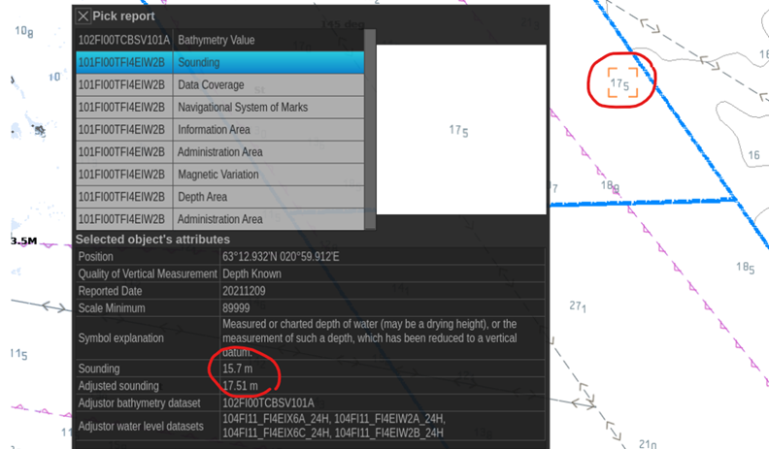
BS E-Nav inputs

Slide 18
Next Meeting(s)
Dedicated S-164 meeting – December dates?
Next meeting December 8th
AOB?

